Slide 1
Platform As A Service
PaaS
A layer on top of IAAS
via a cloud service provider’s hosted infrastructure

Slide 2
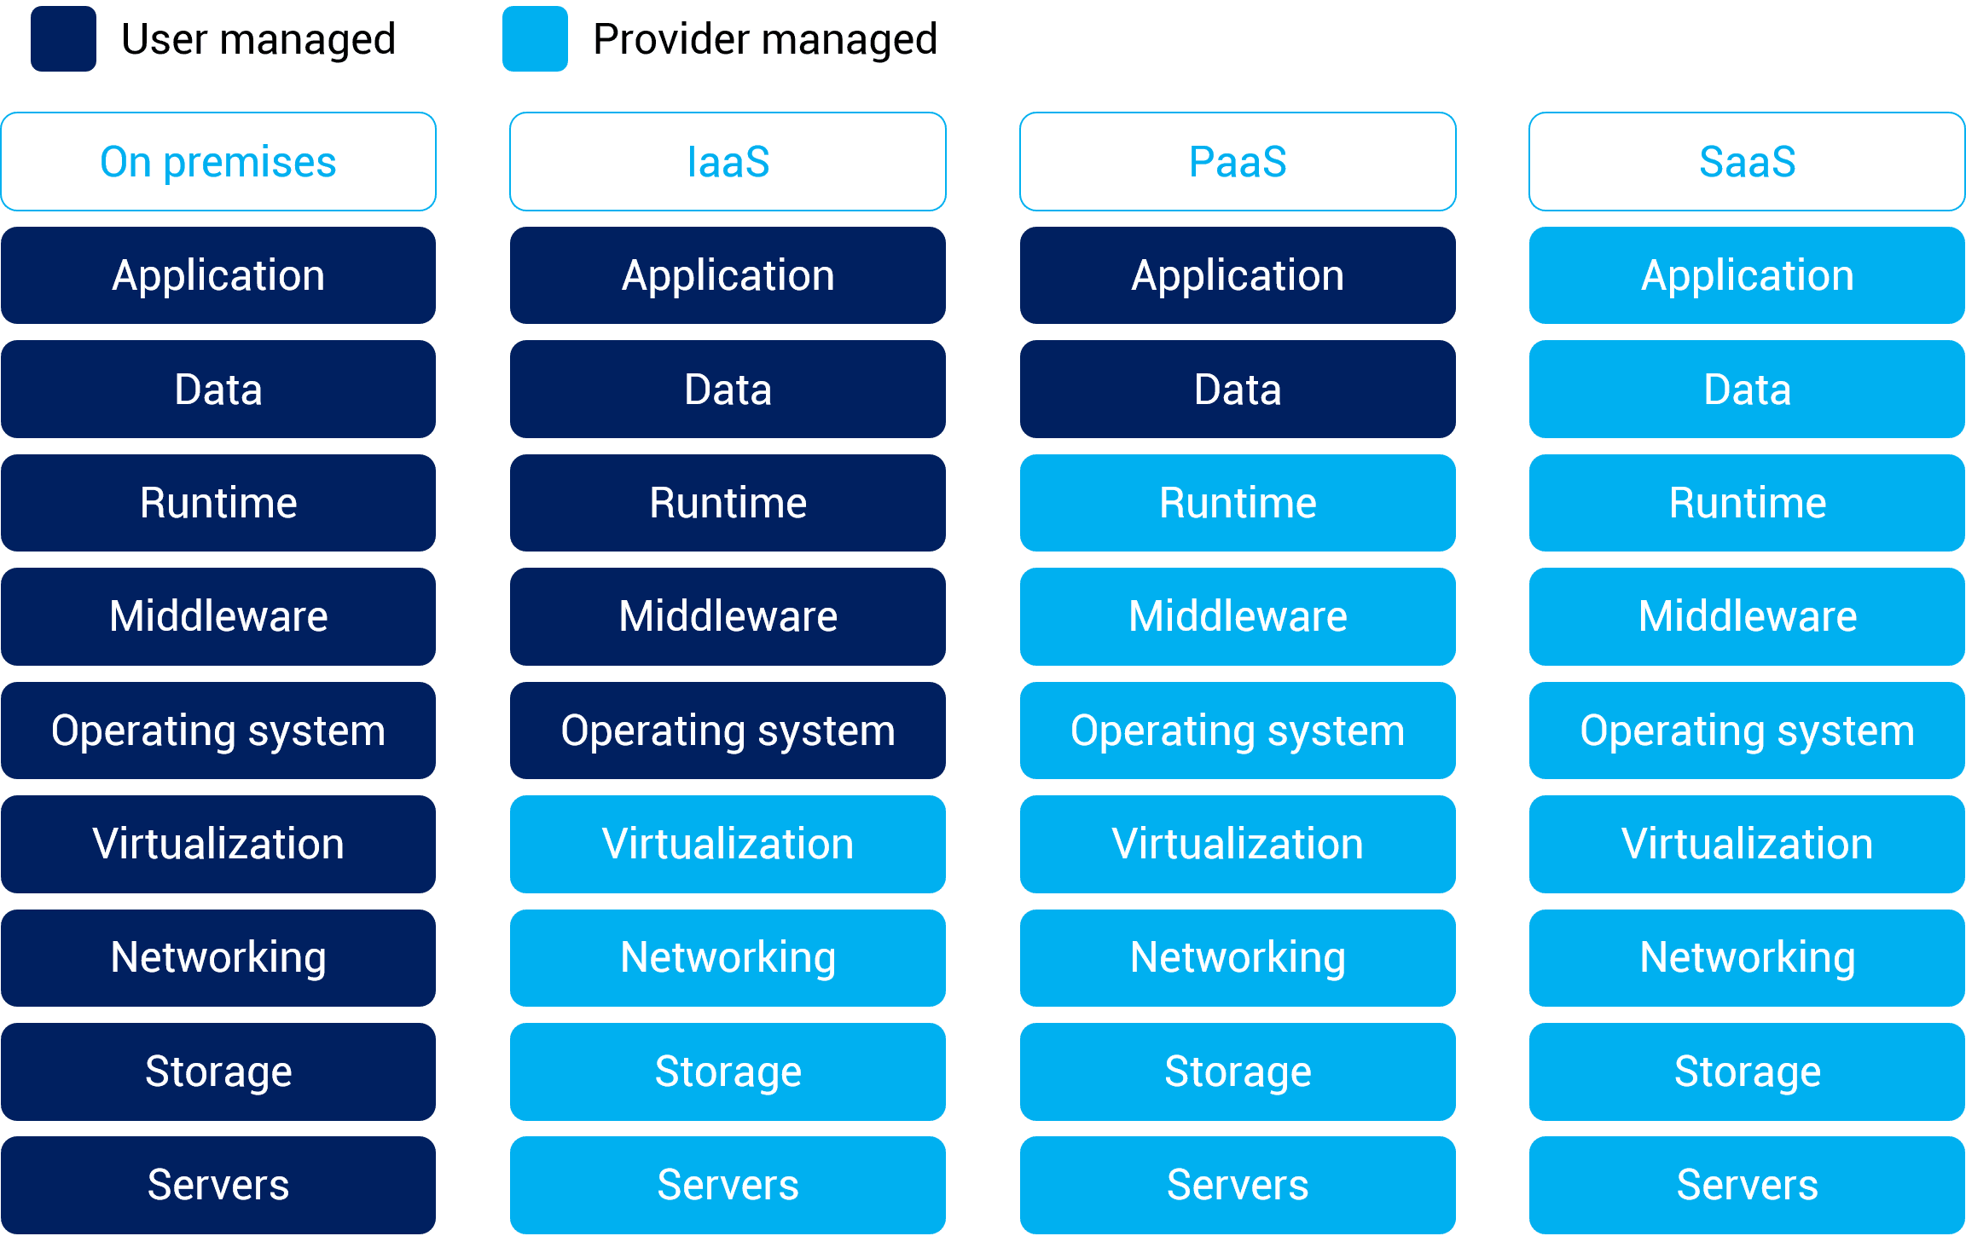

Slide 3
A PaaS vendor provides hardware and software tools over the internet
PaaS uses virtualization to offer an application-development platform to developers or organizations
Users use these tools to develop applications.
PaaS users tend to be developers.
Developers don’t need to start from scratch when creating applications, saving them a lot of time (and money) on writing extensive code.
Notes:
It’s kind of like the difference between hiring a venue to put on a show vs. building a venue to put on a show.
The venue stays the same, but what you create in that space is unique.

Slide 4
AWS Elastic Beanstalk is a service for deploying and scaling web application and services developed with Java, NET, PHP, Node.js, Python, Ruby, Go and Docker on familiar services such as Apache, Nginx, Passenger and IIS.
Microsoft Azure App Services is designed by Microsoft for building, testing, deploying and managing applications and services through Microsoft-managed data centers.
Google App Engine provides web app developers and enterprises with access to Google’s scalable hosting and tier 1 internet service. The App Engine requires that apps be written in Java or Python, store data in Google BigTable and use the Google query language.
Heroku, Force.com, Apache Stratos.

Slide 5
Other advantages include the following:
Cost Effective:
No need to purchase hardware or pay expenses during downtime
Time Savings:
No need to spend time setting up/maintaining the core stack
Speed to Market:
Speed up the creation of apps
Increase Security:
PaaS providers invest heavily in security technology and expertise
Dynamically Scale:
Rapidly add capacity in peak times and scale down as needed
Flexibility:
Allows employees to log in and work on applications from anywhere

Slide 6
AWS Elastic Beanstalk

Slide 7
An easy-to-use service for deploying and scaling web applications and services
Developed with Java, .NET, PHP, Node.js, Python, Ruby, Go, and Docker on familiar servers such as Apache, Nginx, Passenger, and IIS.
Simply upload your code and Elastic Beanstalk automatically handles the deployment, from capacity provisioning, load balancing, auto-scaling to application health monitoring.
There is no additional charge for Elastic Beanstalk - you pay only for the AWS resources needed to store and run your applications.

